Slide 1
Mapping Articulated Pathways (MAP) for Veterans with Credit for Prior Learning (CPL)
TN
Tuesday, October 22nd, 2024 (9:45AM-10:45AM) MSC 2406 B
Terence Nelson | Director of Academic and Institutional Partnerships, California MAP Initiative
Calvin Klein Gloria | Program Manager, California MAP Initiative (U.S. Navy Veteran)

Slide 2
What is Credit for Prior Learning?
TN
CPL is college credit awarded for validated college-level skills and knowledge gained outside of a college classroom. Students' knowledge and skills might be gained through experiences such as:
Military Training
Industry Certification
Credit by Exam
Standardized Assessment
Portfolio Review
JB

Slide 3
Big Bump
TN
CPL Bump with 15 units: 49% vs. 27%.
Reduced time to degree: 9-14 months.
Savings 69K for CA & 48K for U.S. veterans.
Enrollment: +17.5 units.
Boost in Access and Outreach: Quick and affordable credentials.
Validation and Motivation (1st Time College).
JB
³²Klein-Collins, R., Et al. (2020). The PLA Boost: Fact Sheet. Website: https://www.wiche.edu/wp-content/uploads/2020/12/PLA-Boost-Fact-Sheet-CAEL-WICHE-Revised-Dec-2020.pdf

Slide 4
Why CPL and Why Now?
TN
Barriers to completing educational goals:
Finances (56%)
Family obligations (28%)
GI Bill benefits expire before completion (25%)
Disability and wellness (23%)
Job and school conflict (22%)
JB
C. Zoli, Et al. Missing Perspectives: Servicemembers’ Transition. P. iii

Slide 5
Why CPL and Why Now?
TN
44% have service-connected disability.
47% of those have disability rating >60%.¹⁷
Disabilities associated with psychological distress (e.g., depression, PTSD, and stress associated with finances).¹⁸
These issues add to transition stress.
JB
¹⁷U.S. Bureau of Labor Statistics (2021). Employment Situation of Veterans Summary. Retrieved July 21, 2022. Website: https://www.bls.gov/news.release/vet.nr0.htm
¹⁸Vogt DS, Tyrell FA, Bramande EA, et al. (2019). U.S. military veterans’ health and well-being in the first year after service. American Journal of Preventive Medicine. 2020;58:352-360. Retrieved July 20, 2022. Website: https://pubmed.ncbi.nlm.nih.gov/31902684/

Slide 6
Why CPL and Why Now?
TN
45,000 veterans and active-duty committed suicide over the past six years--more than 20 per day.¹⁹
Strong link between transition stress and suicide rate.²⁰
Suicide hazard 2.5 times higher within first year of separation.^{21,22}
Fewer years of education = higher suicide hazard when compared to those with a Bachelor’s.²¹
¹⁹Korb, L. (2019, December 4). Caring for U.S. Veterans: A Plan for 2020. Center for American Progress. Retrieved January 1, 2022. Website: https://www.americanprogress.org/article/caring-u-s-veterans-plan-2020/#fn-478034-6
²⁰Ravindran C, Morley SW, Stephens BM, Stanley IH, Reger MA. (2020). Association of Suicide Risk with Transition to Civilian Life Among US Military Service Members. JAMA Network Open. 2020;3(9):e2016261. doi:10.1001/jamanetworkopen.2020.16261. Website: https://jamanetwork.com/journals/jamanetworkopen/fullarticle/2770538
²¹Shen Y-C, Cunha JM, Williams TV. (2016). Time-varying associations of suicide with deployments, mental health conditions, and stressful life events among current and former US military personnel: a retrospective multivariate analysis. Lancet Psychiatry. 3(11):1039-1048. doi:10.1016/S2215-0366(16)30304-2. Website: https://www.thelancet.com/journals/lanpsy/article/PIIS2215-0366(16)30304-2/fulltext
²²Kapur N, While D, Blatchley N, Bray I, Harrison K. (2009). Suicide after Leaving the UK Armed Forces —A Cohort Study. PLoS Med 6(3): e1000026. Website: https://doi.org/10.1371/journal.pmed.1000026
JB

Slide 7
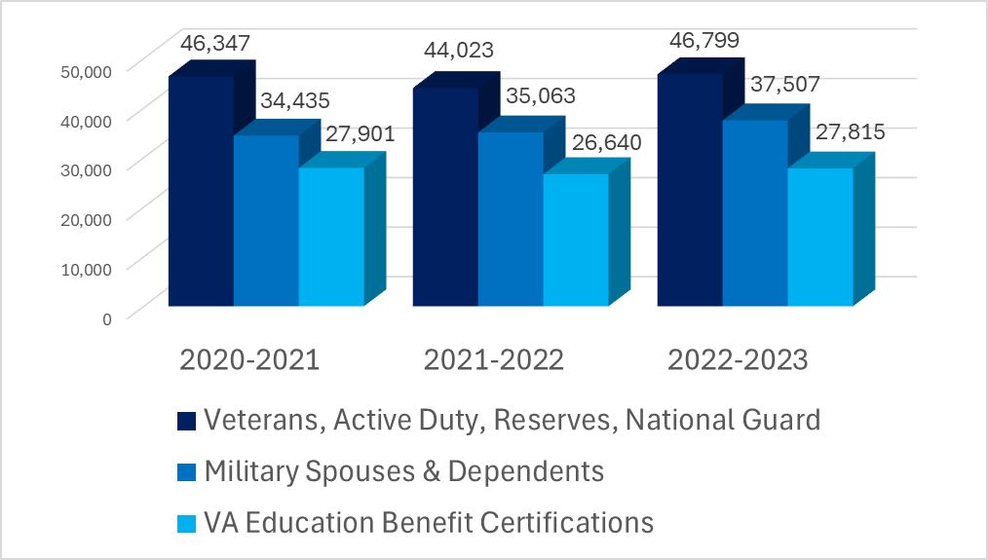
Military Affiliated Students
TN
Military
Affiliated
Students
JB

Slide 8
Policies/Compliance
TN
State & Federal Regulations:
Title V Section 55050 (a) (d) (j) (k) (California)
Title 38 & School Certifying Official (SCO) Handbook – Prior Credit
VA Compliance Visits
CCCCO Veterans Resource Center Minimum Standards (California)
JB

Slide 9
Title 5 Section 55050
TN
(j) …a student, upon completion of their educational plan…shall be referred to the college's appropriate authority for assessment of prior learning if the student is a veteran or an active-duty member of the armed forces, holds industry-recognized credentials, or requests credit for a course based on their prior learning.
(k) The policies for assessments adopted by the governing board of a community college shall offer students an opportunity to accept, decline, or appeal decisions related to the award of credit…
JB

Slide 10
Title 38 & SCO Handbook – Prior Credit
TN
"One of the criteria for approval of any school for Veterans' training is that it reviews prior credit and grant credit as appropriate to a VA student's current program."
"...Schools must evaluate prior credit, grant credit as appropriate, notify the student of the evaluation, and shorten the program certified accordingly. Whenever a student initially enrolls in your school or changes programs at your school a credit evaluation must be completed. VA will review credit evaluations during compliance surveys and credit evaluation records must be kept and made available to VA upon request."
"Schools should make every effort to obtain transcripts to comply with the requirement to evaluate and grant credit where appropriate.
"Reviews of prior credit policies will be conducted during compliance surveys and treated as approval issues if the school is not complying."
JB

Slide 11
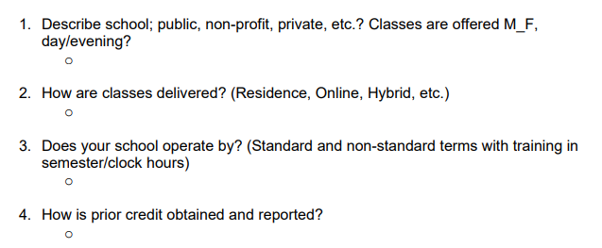
VA Compliance (Audit) Visits
TN
JB

Slide 12
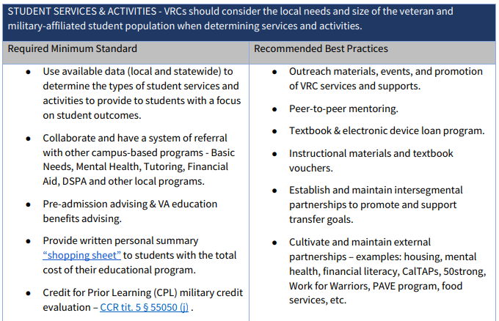
New VRC Standards
TN
JB

Slide 13
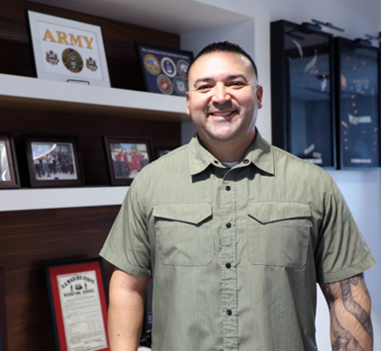
CPL Success Stories - Joey
TN
Institution:
Norco College
Background:
First Sergeant with 21 years in the Reserves, MOS 31B (Military Police).
Experienced 4 overseas deployments and 5 tours of duty.
Currently deployed.
Credit for Prior Learning:
Utilized CPL for progress towards associate degree in Social & Behavioral Studies.
Academic / Career Pursuit:
Working towards associate degree in Social & Behavioral Studies.
Impact:
CPL recognition supports Joey's educational advancement despite active military duties, highlighting the importance of flexibility and recognition of prior military experience in higher education.
CG

Slide 14
What is MAP?
TN
Mapping
Prior Learning & Competencies to College Courses for…
Articulated
Approvals, Awards, Adoptions, Alignment for…
Pathways
Developed with Embedded CPL for Offers, Outreach, Opportunities
CA MAP Initiative Website
MAP CPL Repository
CG

Slide 15
MAP Platform
TN
The MAP Platform is a specialized planning tool tailored for institutions to assess both military and professional experiences, allowing students to earn academic credit.
This tool simplifies the credit transfer process by establishing credit equivalencies (articulations) aligned with ACE (and other) credit recommendations and supporting documents and maintaining a central database that various stakeholders can access and share.
Furthermore, the platform stores and parses supporting documents like JSTs and industry certifications to initiate articulations with prior learning opportunities, maximizing the college credit awarded to service members and working adults.
MAP benefits educational institutions and students alike by making the credit planning and transfer process more efficient, equitable, and transparent. MAP ensures that all students, including service members and working adults, receive the recognition they deserve for their achievements and experiences.
CG

Slide 16
MAP Platform - Successes
TN
Over 8,000 students have been offered CPL/PLA
Over 31,000 units of CPL
Over $181 million in estimated savings, preservation of benefits, and economic impact to students and taxpayers
681 Courses (68 of which are C-IDs) in 175 Subject in 116 different TOP codes
10,000 Military Credit Recommendations from Joint Services Transcripts,
85 Industry Certifications including Dental Hygiene, Dental Assisting, Real Estate, Aviation, EMT/EMS Paramedic, Fire, Law Enforcement, Business, Electrical Apprenticeships, etc.
CG

Slide 17
MAP Platform - Successes
TN
CalVET/CalTAP Integration
CMTE partnership with MCTO (Department of Defense TAP)
MAP Platform and Self-access Module
Faculty Workgroups Designed Similar to ACE yet Locally Focused
Statewide CPL Workgroups
Policy and Regulation Enhancements
Professional Development for Faculty and Counselors/Advisors
MAP Platform and College Landing Pages
Full Sharing and Transparency of CPL Articulations
CG

Slide 18
API Integration – ACE Military Guide
CG
American Council on Education Military Guide – Monthly
ACE ID
Skills/Version
Exhibit Identifiers (Dates, Passing Scores, Locations, Length, Occupation/Course, Type/Number)
Descriptions
Competencies
Instructional Strategies
Methods of Assessment
Credit Recommendations (CR)
Unit Values
CR Levels: V, L, U, G
AC

Slide 19
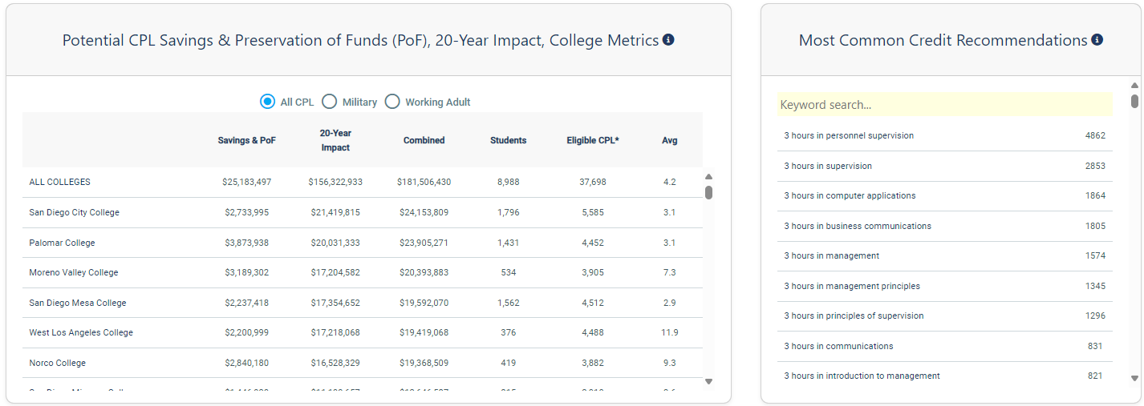
Economic Impact
CG
CG

Slide 20
CPL Repository - Military
CG
CG

Slide 21
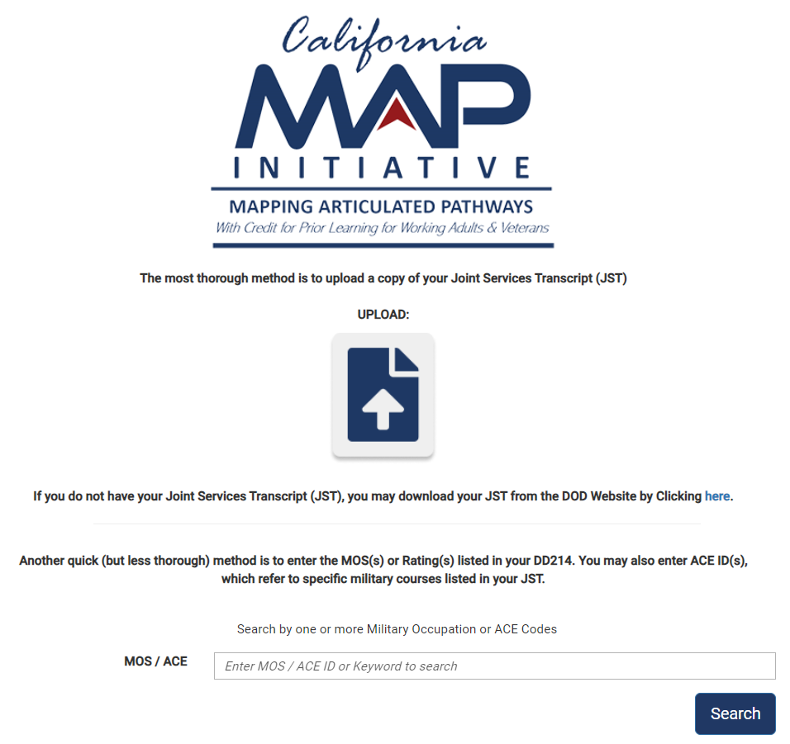
JST Student Upload
CG
CG

Slide 22
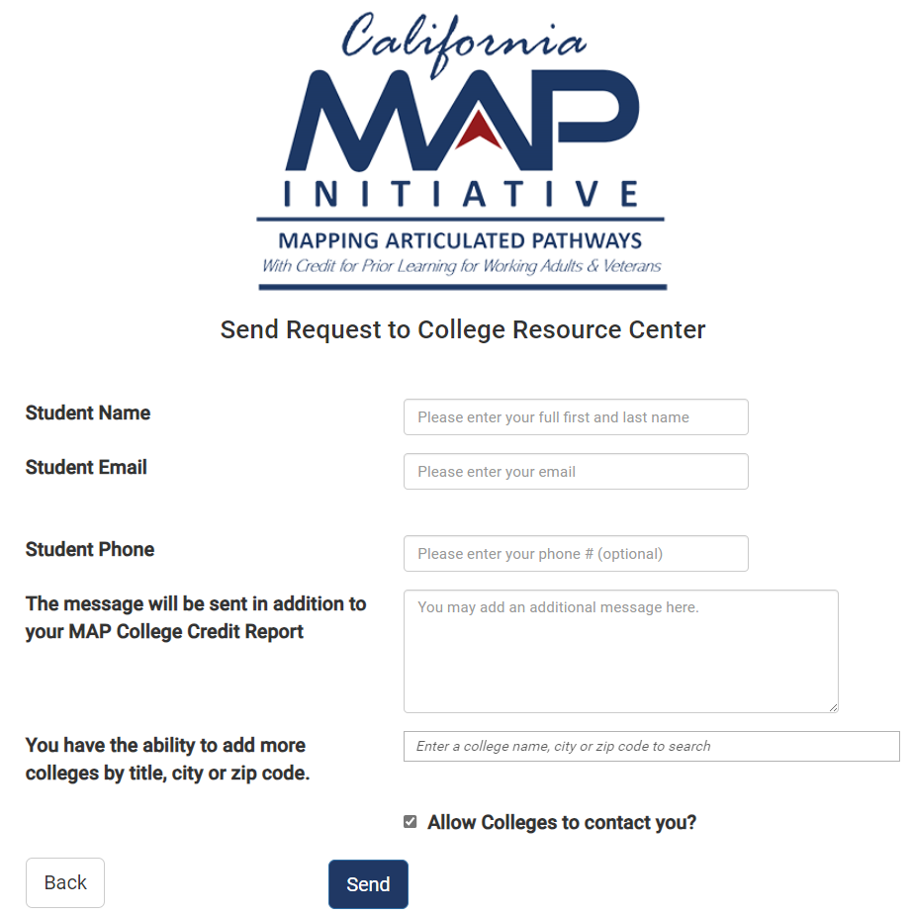
JST Student Upload
CG
CG

Slide 23
Identifying All Military Connected Students
CG
Veterans, Active Duty, Reservists
College Admission Application via CCCApply
Educational Benefit Users
Non-Educational Benefit Users
Walk in with Active Duty/Reservists ID for Priority Registration
CG

Slide 24
Joint Services Transcript
CG
A Joint Services Transcript (JST) is an official academically accepted and approved document provided by the Department of Defense (DOD) that has been approved by the American Council on Education (ACE) to validate a service members military course completions, military occupations, college level test scores and other learning experiences.
Available to service members (Veteran, Active Duty, Reservists) for the following branches: Army, Marine Corps, Navy, and Coast Guard. Available to U.S. Air Force if applicable.
Accepted by more than 2,300 colleges and universities.
Over 5,600 Credit Recommendations from ACE.
JSTs are free of charge (98% accessible via electronically).
Link: https://jst.doded.mil/jst/.
CG

Slide 25
Joint Services Transcript
CG
ACE ID
All courses and occupations reviewed by ACE have a corresponding ACE identification number (ACE ID).
Credit Recommendations (CR)
Credit recommendations listed on a JST are based on each service member’s learning through military experience, academic exam scores, and academic courses completed while in the military. These credit recommendations have been evaluated by the American Council on Education (ACE) and designated in semester hours.
Semester Hours (SH)
ACE uses "Credits", "Hours", or "Semester Hours (SH)" interchangeably which refers to semester units using Carnegie Lecture Hours Equivalent (e.g., 3SH is 3 credits).
ACE CR Levels
V – Vocational | L – Lower | U – Upper | G – Graduate
CG

Slide 26
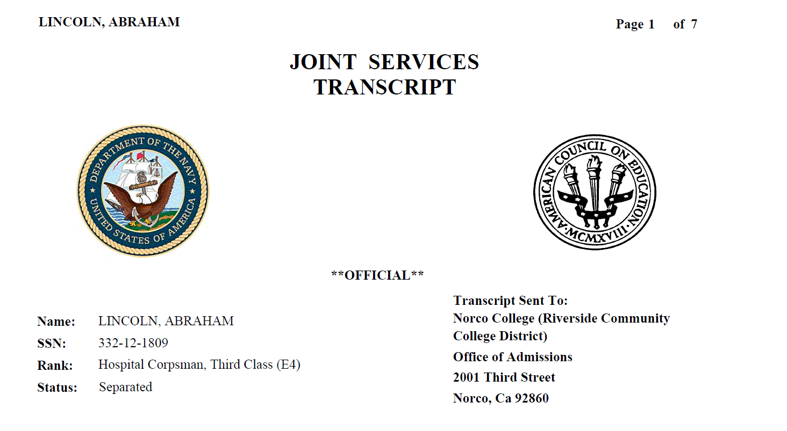
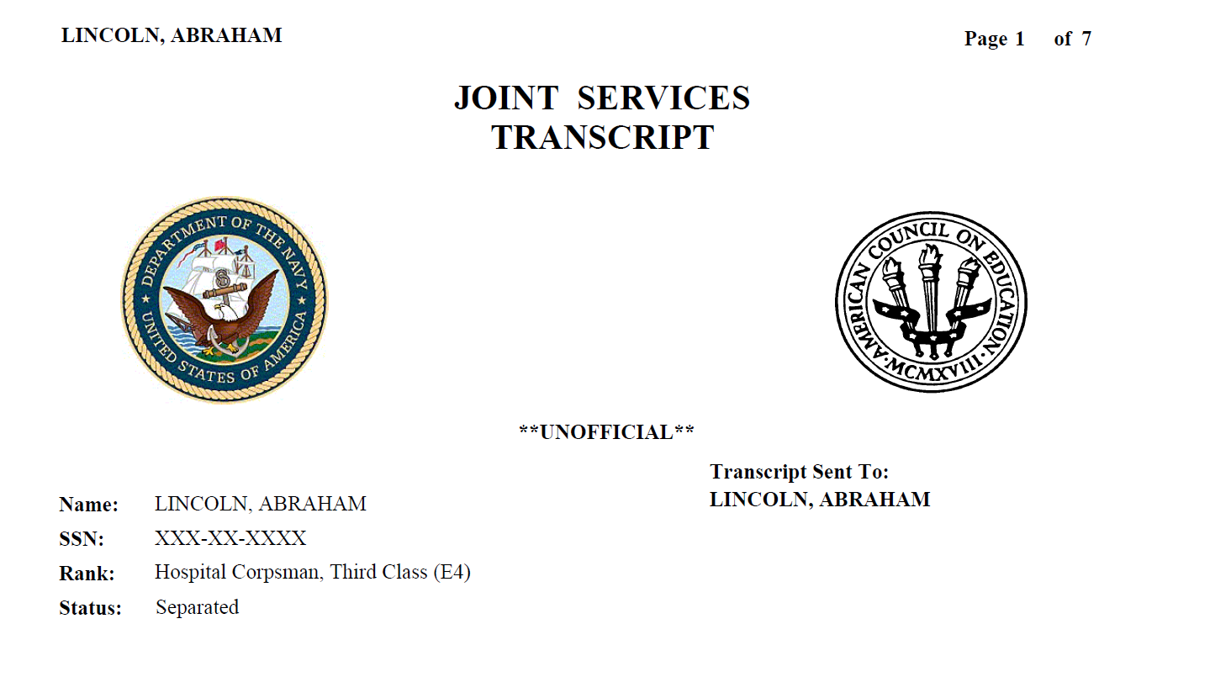
Joint Services Transcript
CG
Official
Unofficial
CG

Slide 27
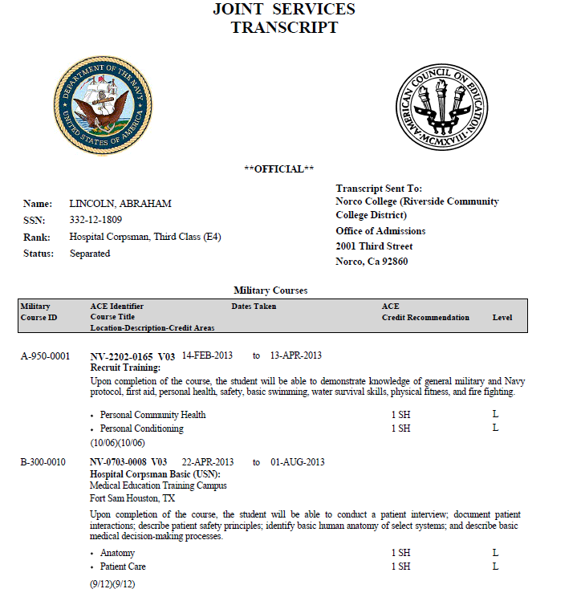
CG
Branch of Service
ACE Seal
Service Member Information
College Recipient
Military Courses
ACE Exhibit Information (Courses)
ACE Credit Recommendation Value
1st: ACE faculty review date
2nd: Administrative adjustments to course data
Level of Credit
CG

Slide 28
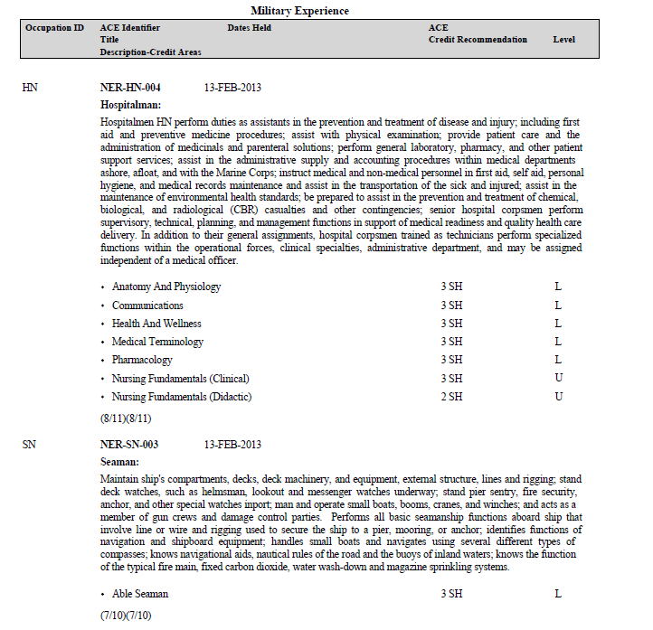
CG
Military Experience
ACE Exhibit Information (Experience)
CG

Slide 29
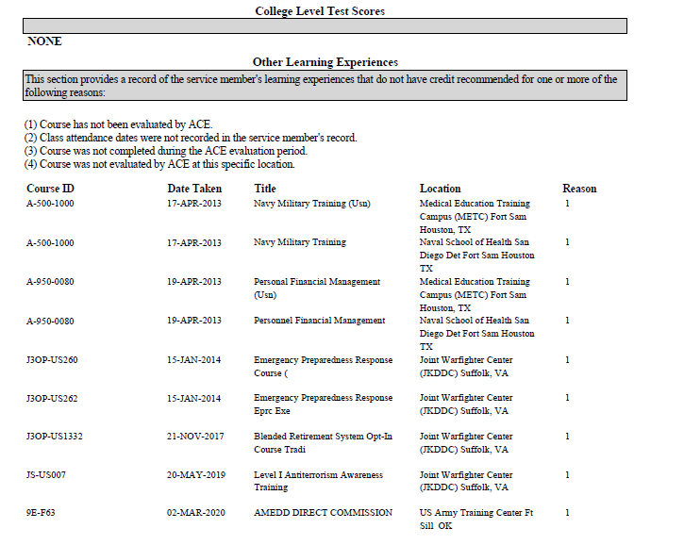
CG
College Level Test Scores
Other Learning Experiences
Service member’s professional education and training experiences that do not have official ACE credit recommendations.
CG

Slide 30
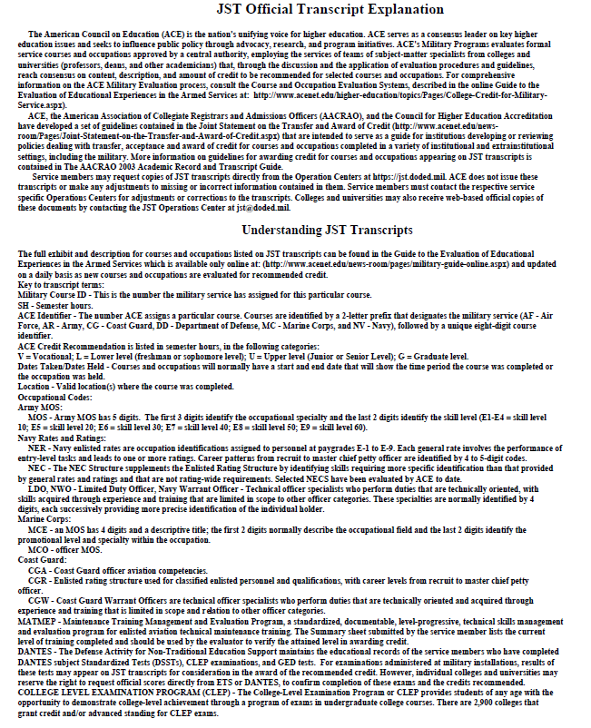
CG
JST Transcript Explanation
Understanding your JST
CG

Slide 31
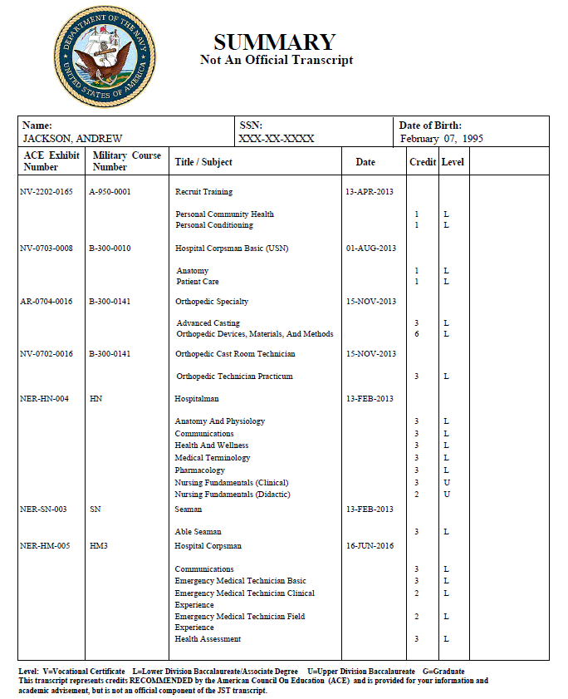
CG
LINCOLN, ABRAHAM
February 12, 1809
CG

Slide 32
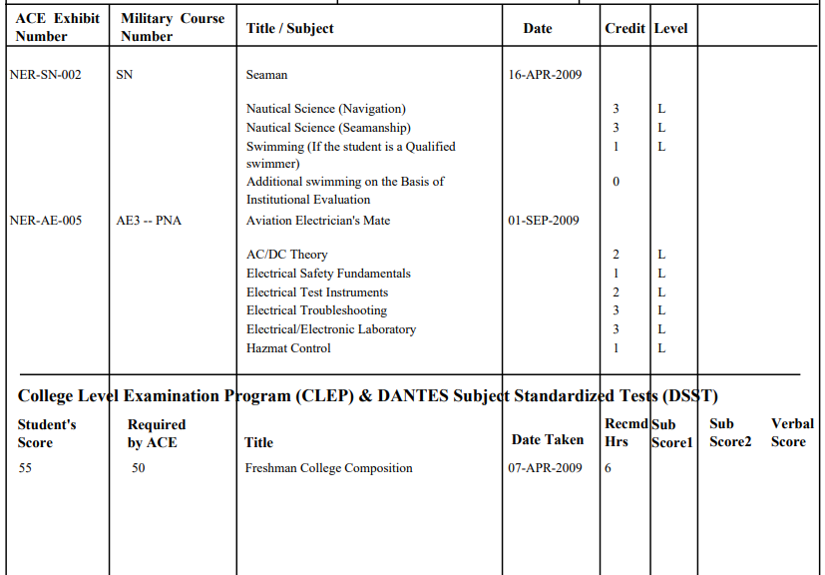
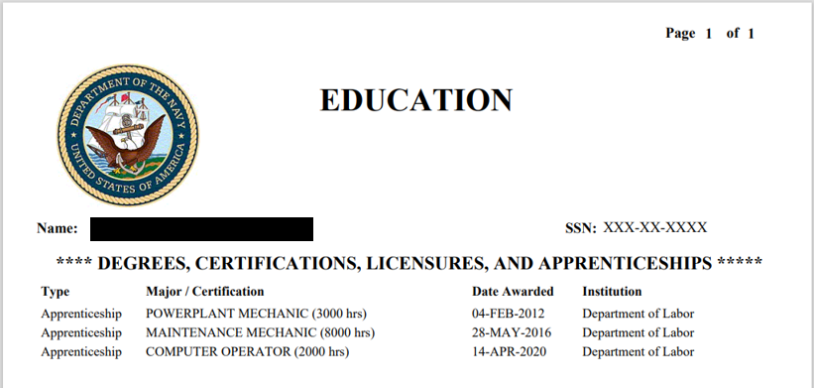
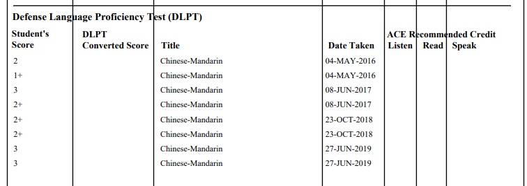
Joint Services Transcript
CG
CG

Slide 33
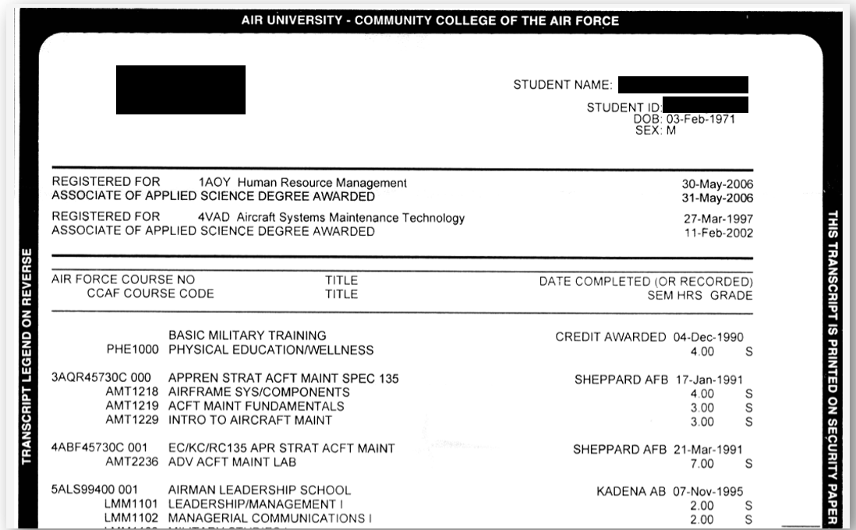
Community College of the Air Force
CG
Sample CCAF Transcript
CG

Slide 34
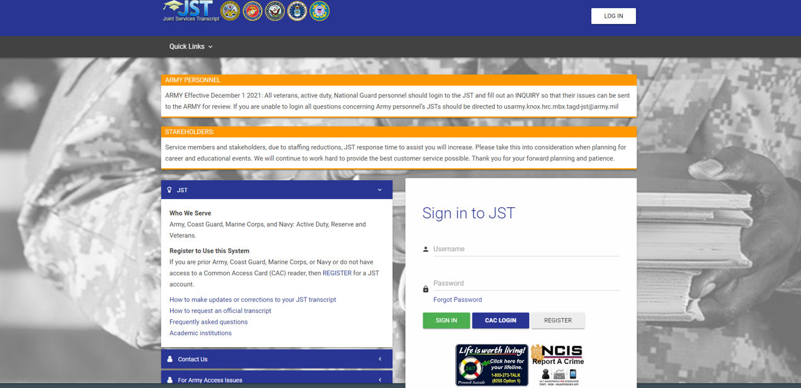
JST Bulk Ordering Method
CG
CG

Slide 35
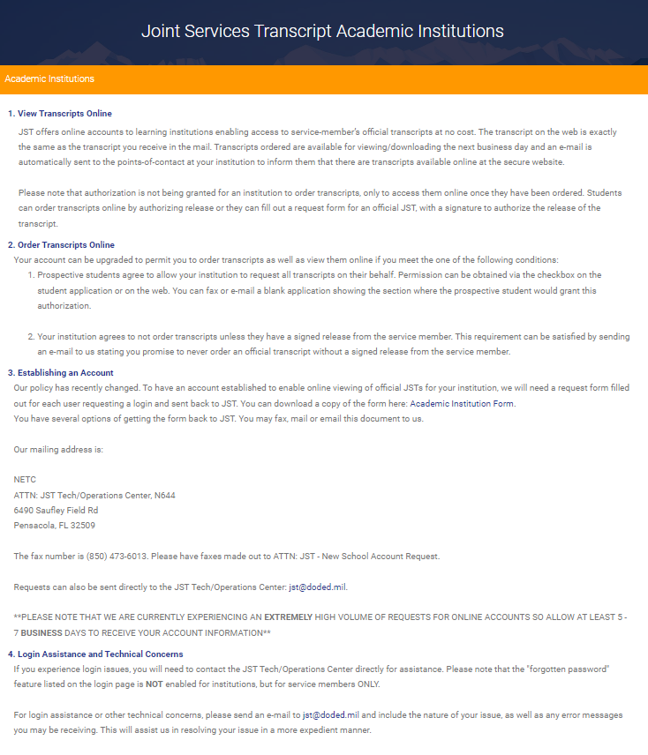
JST Bulk Ordering Method
CG

Slide 36
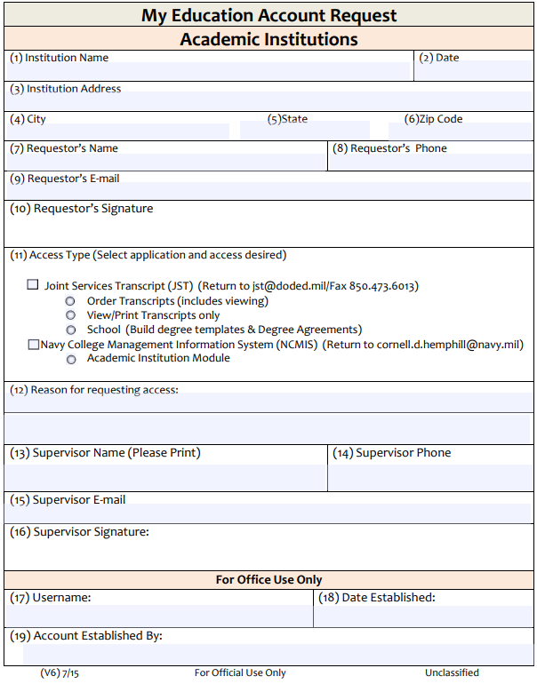
JST Bulk Ordering Method
CG

Slide 37
JST Bulk Ordering Method
CG
Steve.Rogers
College1
CG

Slide 38
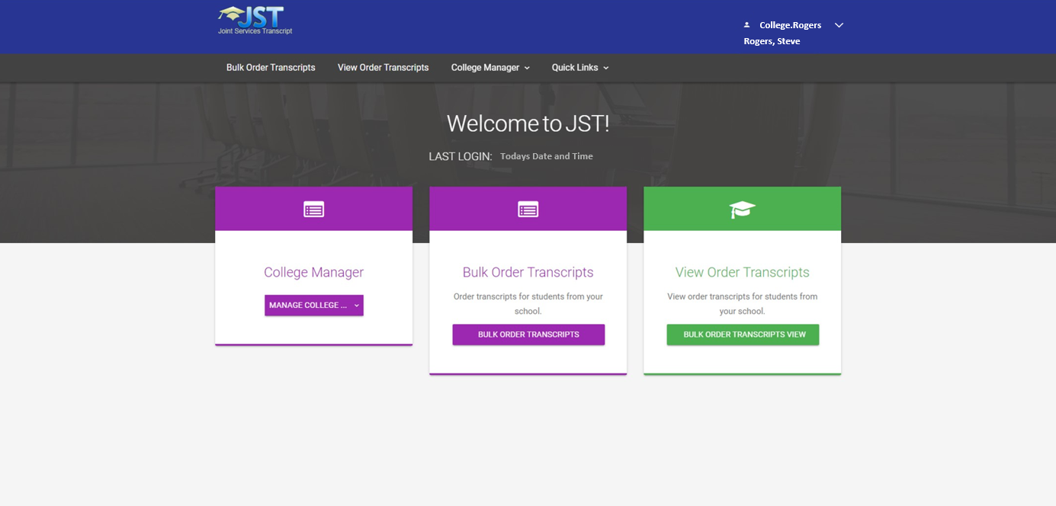
JST Bulk Ordering Method
CG
CG

Slide 39
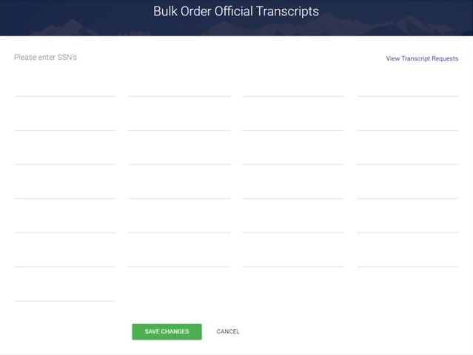
JST Bulk Ordering Method
CG
123456789
987654321
111111111
222222222
333333333
444444444
555555555
CG

Slide 40
JST Bulk Ordering Method
CG
CG

Slide 41
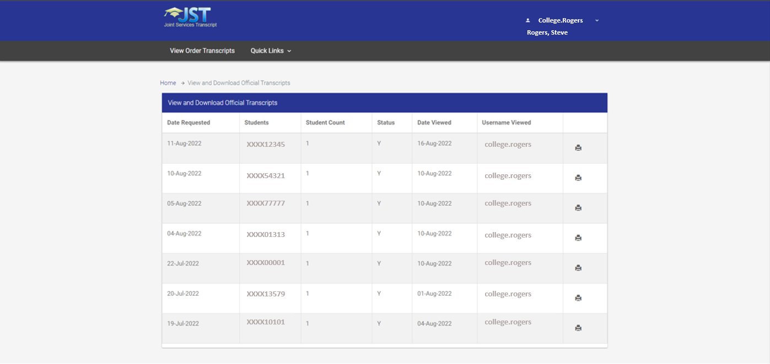
JST Bulk Ordering Method
CG
Recommendation: Save as PDF and save to a secure folder.
Will stay in queue for 30 days.

Slide 42
American Council on Education
TN
The American Council on Education is a national non-profit organization in higher education and serve as an agency to provide credit recommendations based on peer reviewed analysis for educational training.
Authorized by the Department of Defense (DOD).
Nonprofit organization focused on higher education advocacy and leadership.
Represents over 1,700 colleges and universities, including their leaders and institutions.
Advocates for policies enhancing access, equity, and quality in higher education.
Offers programs supporting leadership development and innovation in academia.
Operates the College Credit Recommendation Service (CREDIT®) for workforce training and education credit evaluations.
Conducts research and provides resources to address higher education challenges.
Engages in public policy discussions and initiatives impacting colleges and universities.
Established in 1918, it continues to be a prominent voice in higher education affairs.
JB

Slide 43
ACE Faculty Reviewers
TN
Becoming an American Council on Education (ACE) faculty reviewer involves a selective process. ACE looks for experienced and well-qualified faculty members to serve as reviewers. Generally, the following steps are involved:
Qualifications: Faculty members who are interested in becoming ACE reviewers typically have substantial experience in their academic field, hold advanced degrees, and have demonstrated expertise in curriculum development, teaching, or educational program assessment.
Faculty must be currently teaching at an accredited college or university.
Evaluators from various educational institutions: 4-Year Public and Private Universities, as well as 2-Year Public and Private Colleges.
The reviews are founded on alignment with academic disciplines, ensuring expertise in the specific subject matter.
A minimum of five years' experience is required for eligibility.
Selection and Training: The selection process involves a review of applications, where ACE assesses the applicant’s qualifications, experience, and alignment with the needs of the review process. Selected applicants might undergo training or orientation to understand ACE’s review process, guidelines, and standards.
Ongoing Commitment: Faculty reviewers who are accepted into ACE’s pool of reviewers might be called upon periodically to evaluate courses, programs, or other educational initiatives based on their expertise and availability.
JB

Slide 44
ACE Faculty Reviewers
TN
Why is ACE a trustworthy organization?
Expertise and Rigor: ACE utilizes teams of subject-matter specialists from various academic backgrounds—professors, deans, and academicians—who thoroughly examine courses and occupations. Their rigorous evaluation involves discussions, application of evaluation procedures, and the use of guidelines to reach a unanimous agreement on credit recommendations.
Academic Diversity: The team conducting the evaluations represents a diverse array of colleges and universities. This diversity ensures a comprehensive and inclusive evaluation process, taking into account various perspectives and academic standards.
Central Authority Approval: The formal service courses and occupations evaluated by ACE are approved by a central authority, indicating a standardized and authorized process for evaluating these programs.
Faculty Consensus: All credit recommendations undergo a rigorous review by faculty evaluators. Their evaluations must attain 100% consensus, highlighting a thorough and comprehensive assessment process that values collective agreement among experts in the field.
Longstanding Reputation: ACE has a longstanding history and reputable standing in evaluating military courses and occupations, which adds to the trustworthiness of their assessments.
Overall, the collaborative, multi-disciplinary approach involving experts from various academic backgrounds, as well as their stringent evaluation procedures, reinforces the reliability and credibility of ACE's assessments.
JB

Slide 45
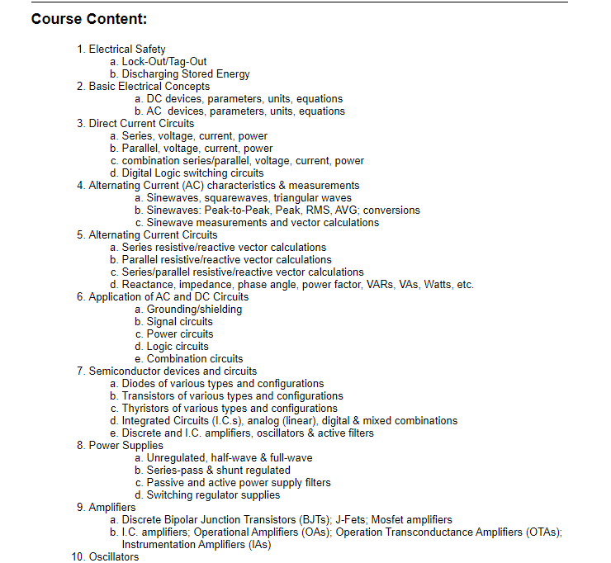
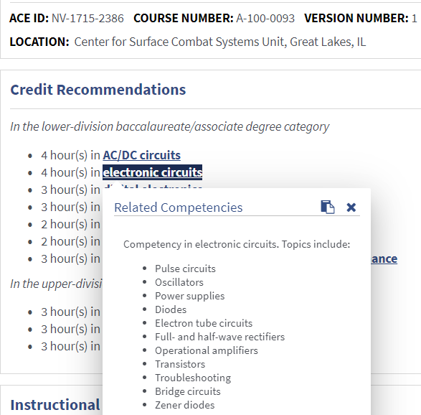
MOS/RATE - ACE ID - Credit Recommendations
TN
JB

Slide 46
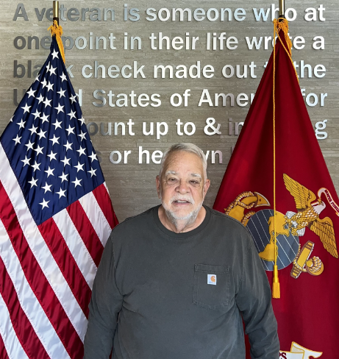
CPL Success Stories - John
CG
Institution:
Norco College
Background:
John Rigler, U.S. Marine Corps veteran with experience as an Avionics Technician (AT).
Credit for Prior Learning:
Utilized Military CPL (JST) for accelerated progress in Construction Technology.
Academic Pursuit:
Studying Construction Technology at Norco College.
Impact:
CPL facilitated John's transition from military service to higher education, supporting his career goals in construction technology.
CG

Slide 47
MOS/RATE – Program of Study
CG
ARMY
Combat Engineer (12B)
Plumber (12K)
Military Police (31B)
Human Resources Specialist (42A)
NAVY
Aviation Machinist’s Mate (AD)
Culinary Specialist (CS)
Damage Controlman (DC)
Hospital Corpsman (HM)
MARINE CORPS
Rifleman (0311)
Cyber Security Technician (0689)
Electrician (1141)
Automotive Intermediate Mechanic (3522)
COAST GUARD
Health Services Technician (HS)
Information Systems Technician (IT)
Musician (MU)
Public Affairs Specialist (PA)
CG

Slide 48
MOS/RATE – Program of Study
CG
Aligning MOS/Rate (Credit Recommendations) with Program of Study
ARMY
MOS 31B (Military Police)
Major Related to MOS/Rate
AS – Administration of Justice
Major Not Related to MOS/Rate
CSU Transfer AA in Social and Behavioral Studies
COURSE
AREA
ELECTIVE
CG

Slide 49
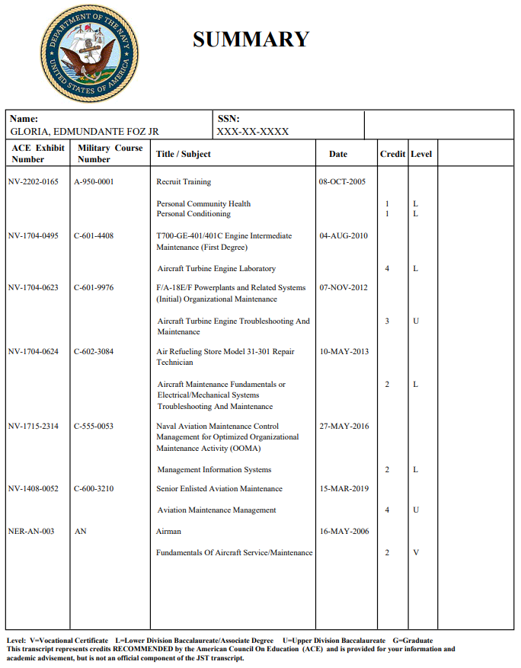
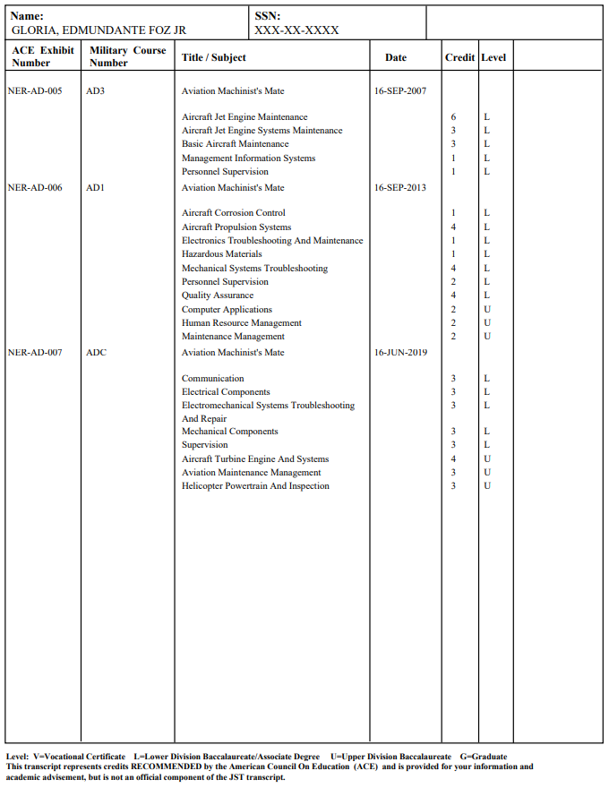
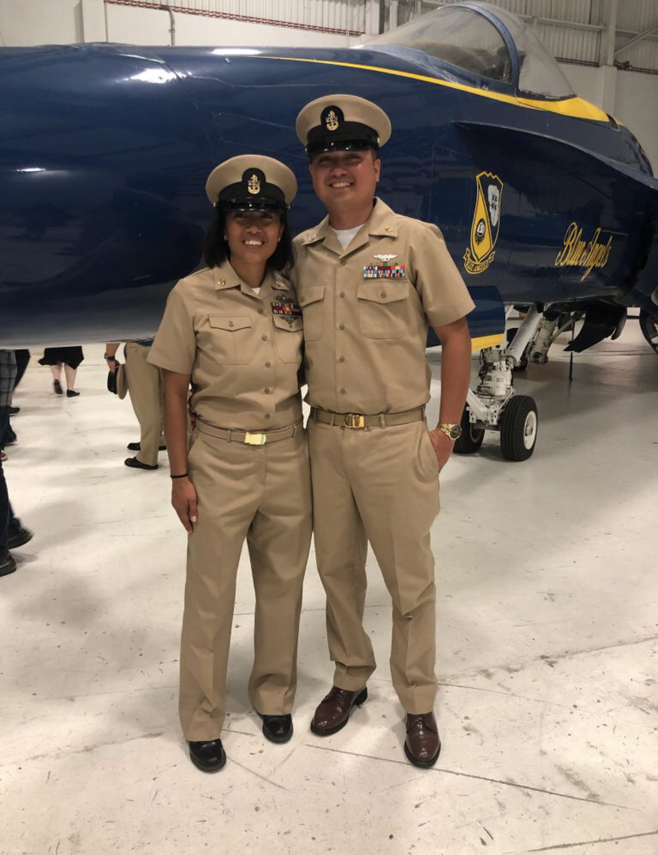
Demonstration
CG
CG

Slide 50
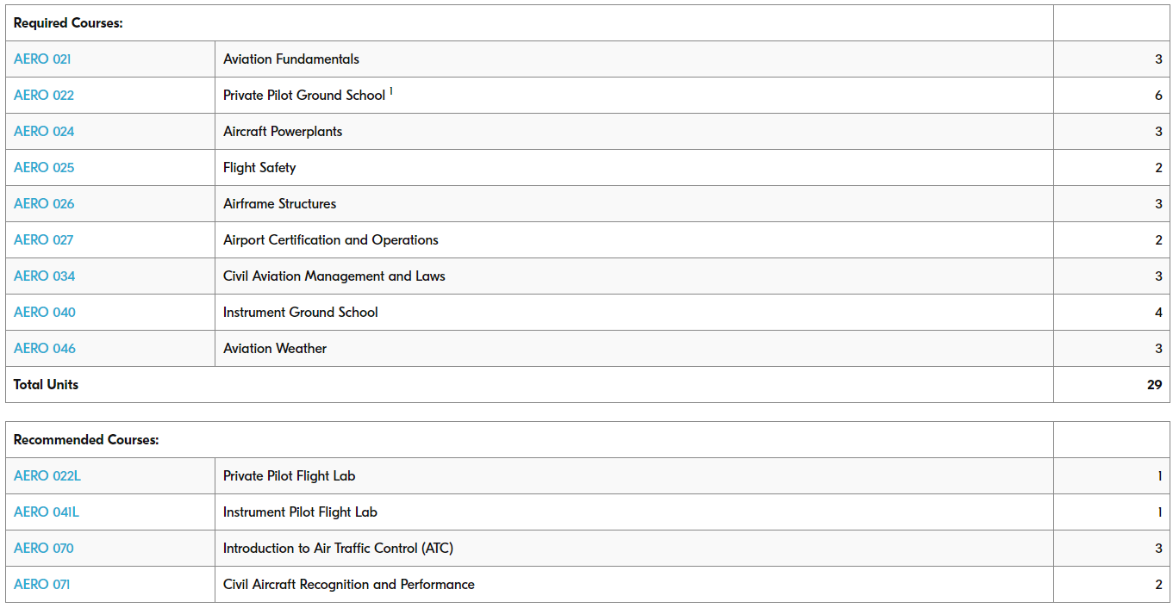
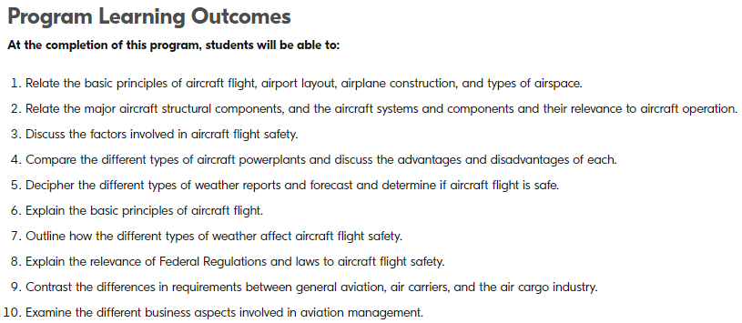
Demonstration
CG
CG

Slide 51
Demonstration
CG
CG
CG

Slide 52
Demonstration
CG
CG
CG

Slide 53
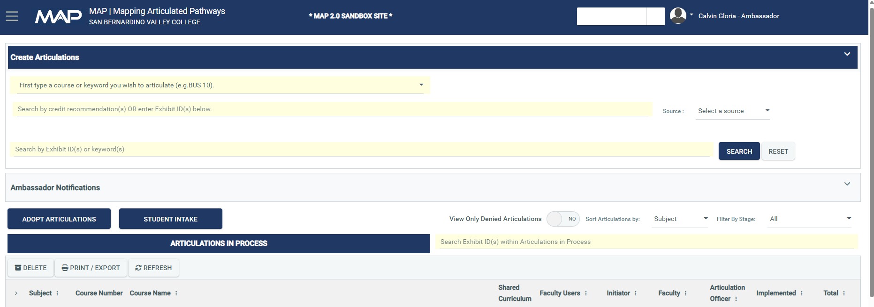
Demonstration
CG
Initiator
CG

Slide 54
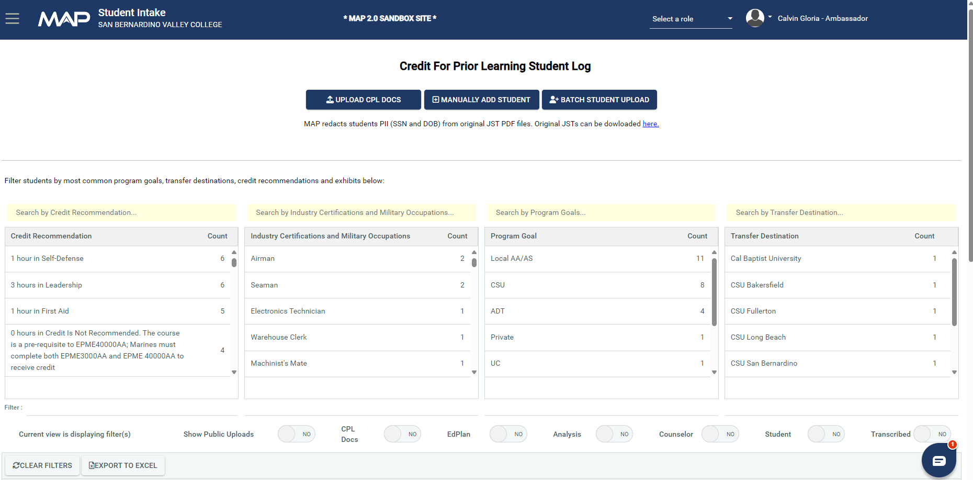
Demonstration
CG
Initiator
CG
CG

Slide 55
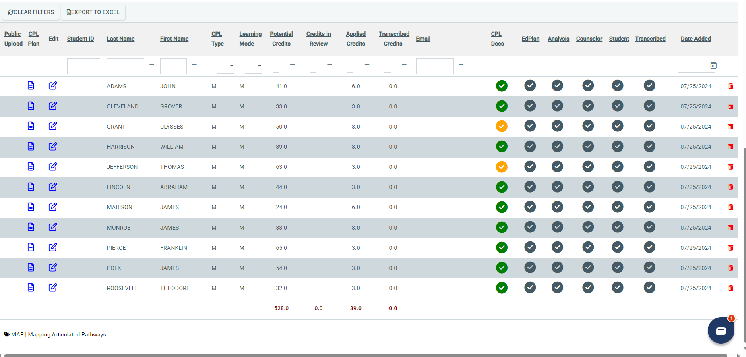
Demonstration
CG
CG
CG

Slide 56
Demonstration
CG
Initiator
CG
CG

Slide 57
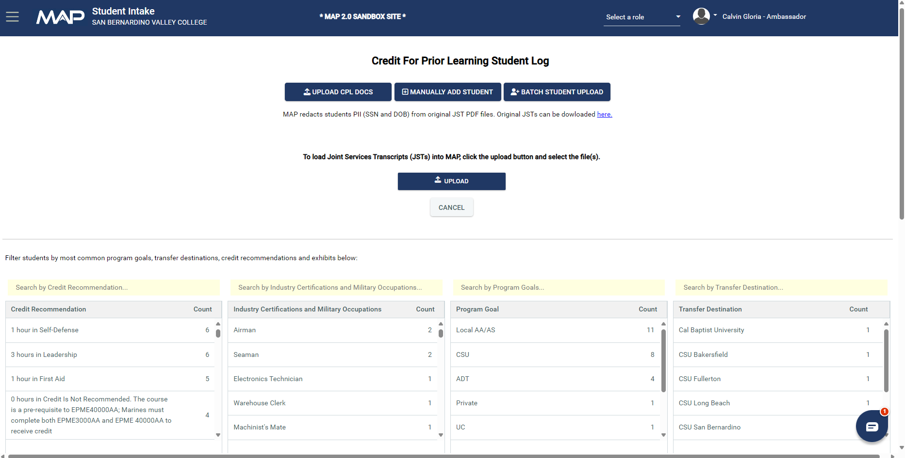
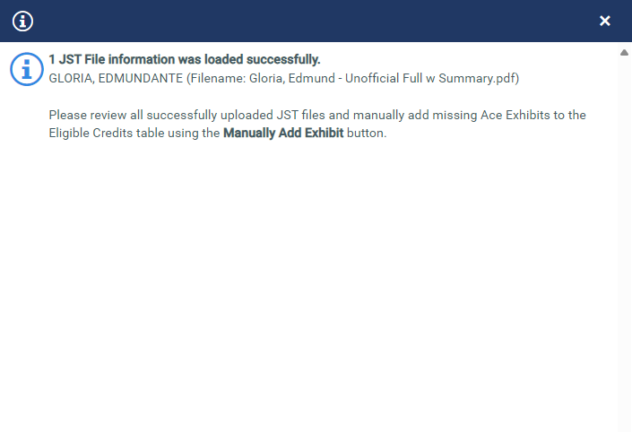
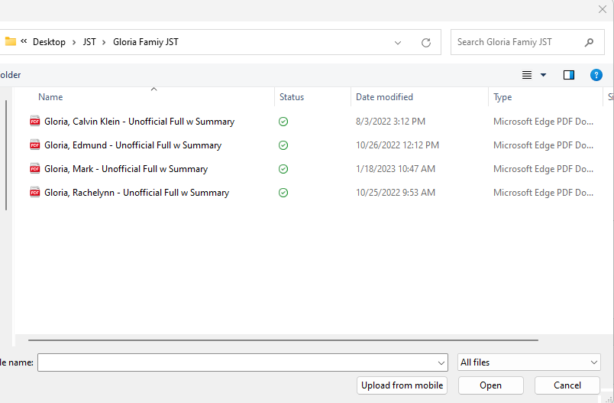
Demonstration
CG
Initiator
Gloria, Edmund – Unofficial Full w Summary
CG
CG

Slide 58
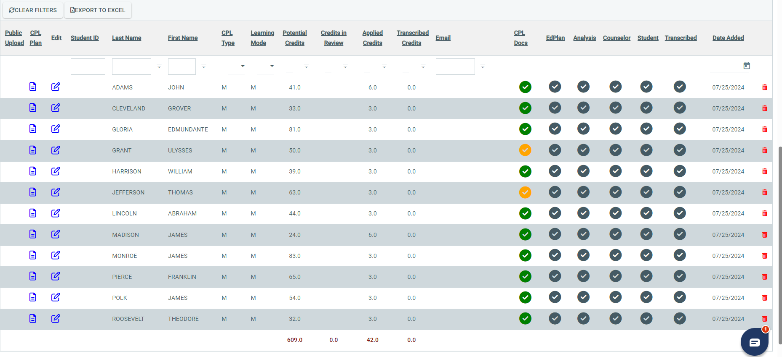
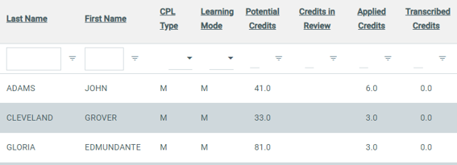
Demonstration
CG
07/30/2024
CG

Slide 59
Demonstration
CG
07/30/2024
CG

Slide 60
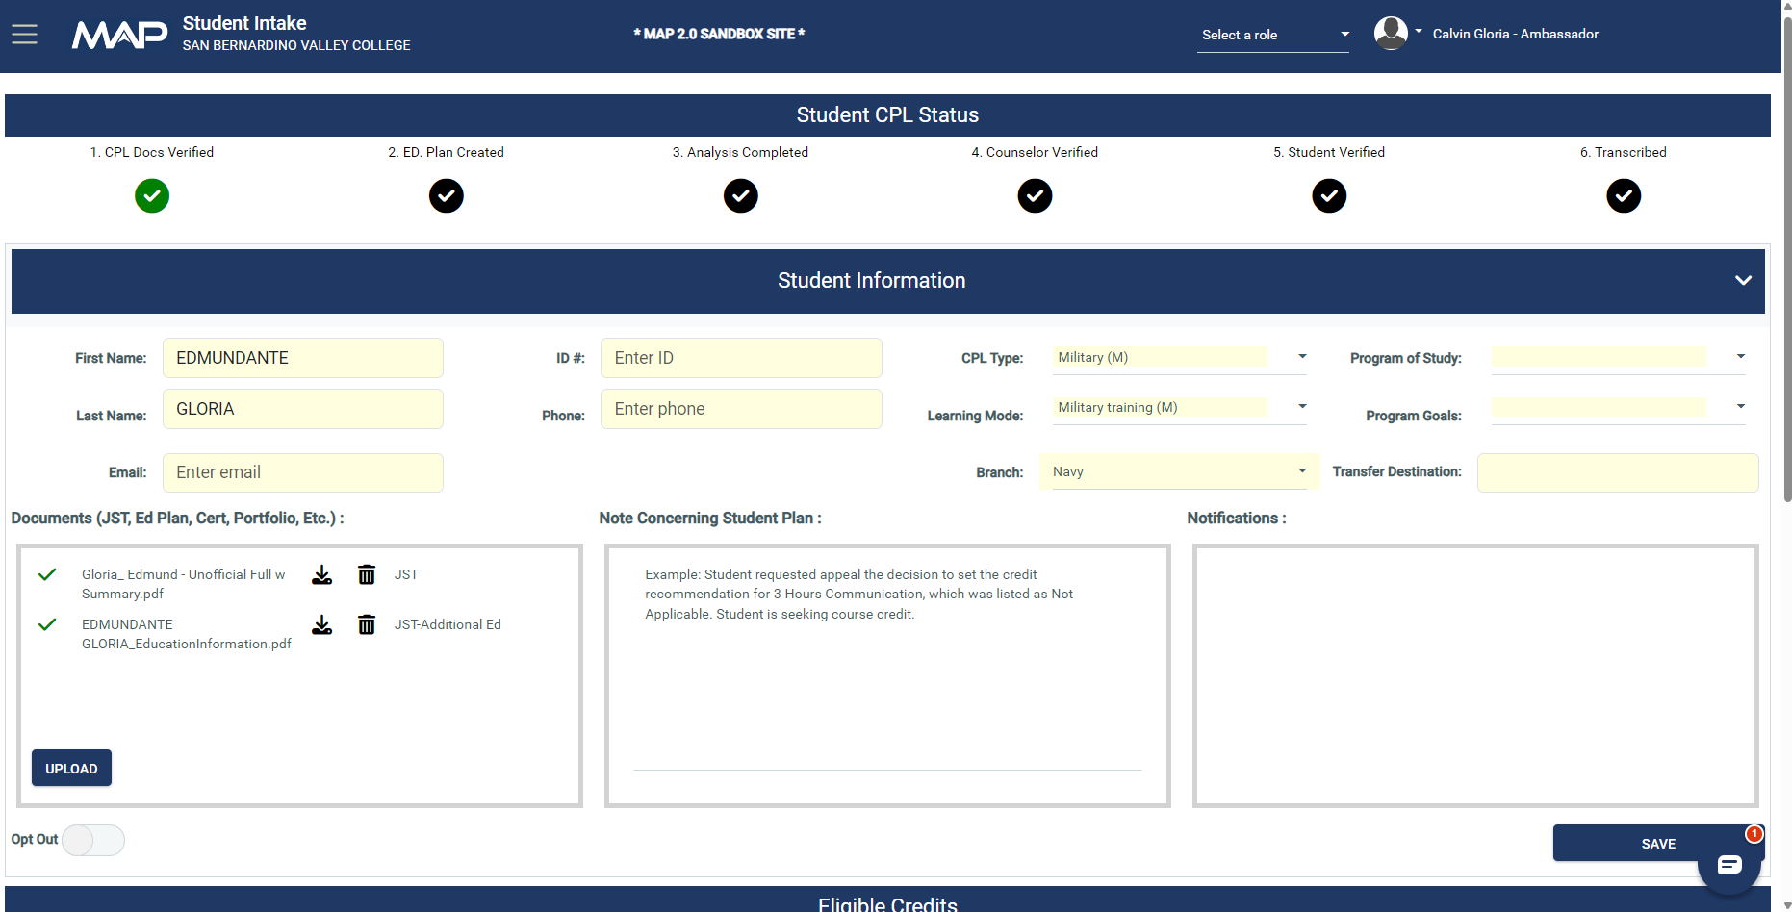
Demonstration
CG
Initiator
1234567
Military (M)
Flight Operations and Manage
(111)111-1111
Military Training (M)
Local AA/AS, CSU
e.g@sbvc.edu
CSULA
CG
CG

Slide 61
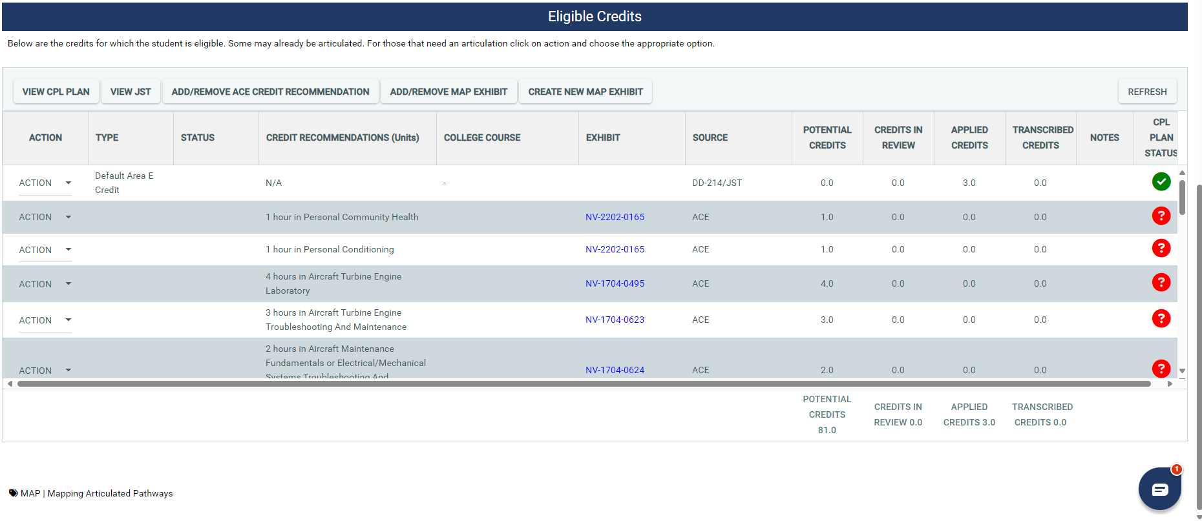
Demonstration
CG
CG

Slide 62
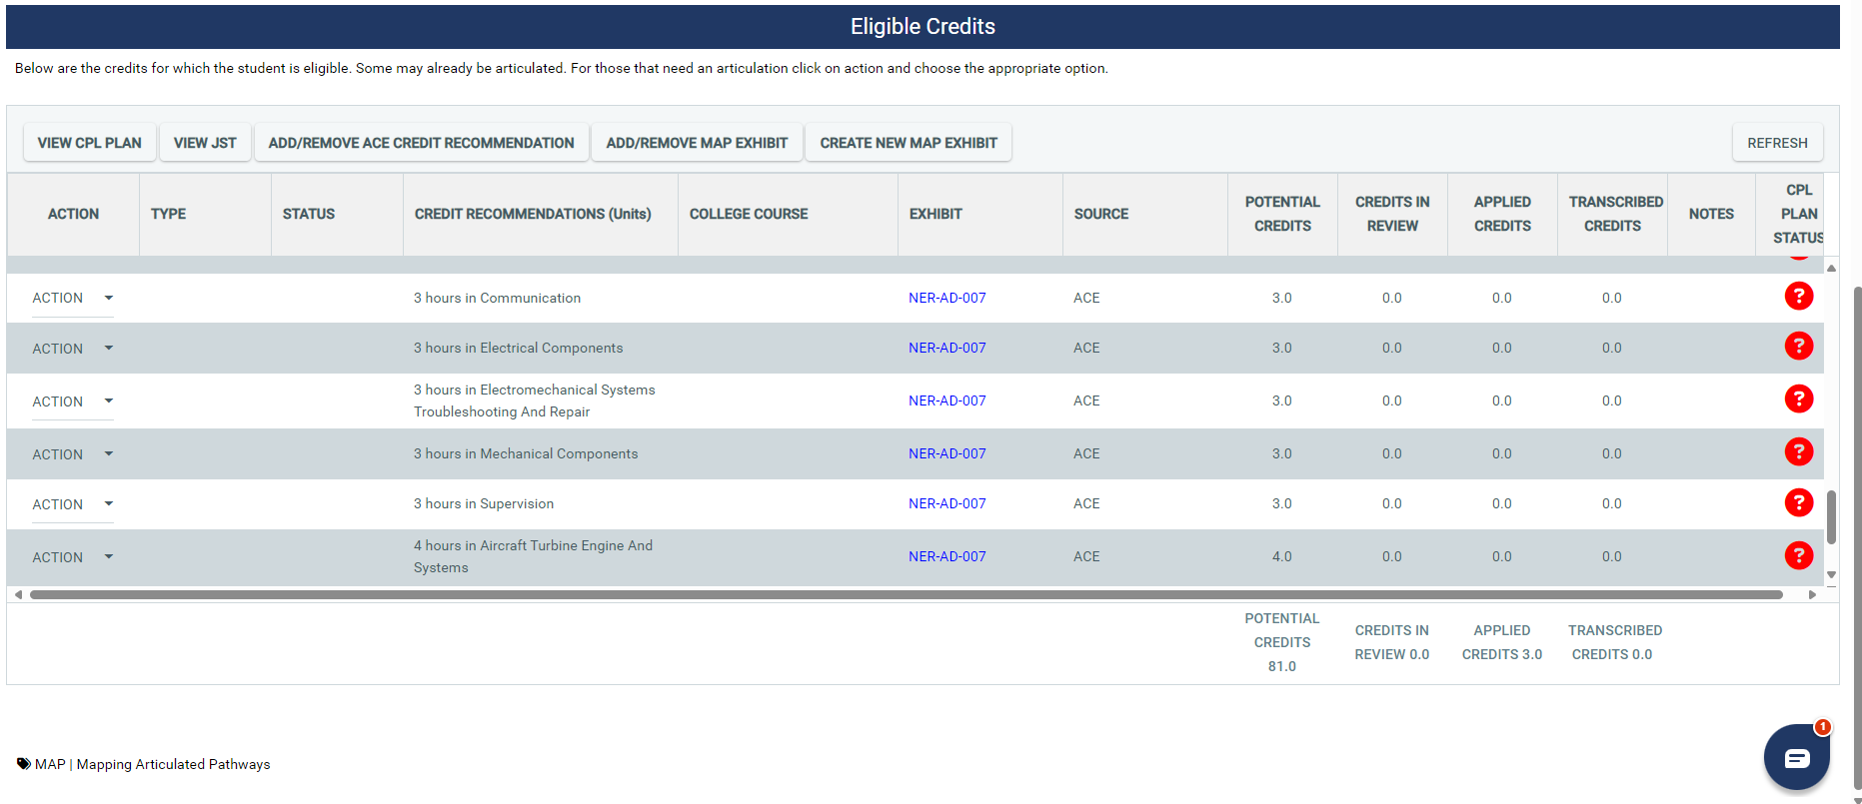
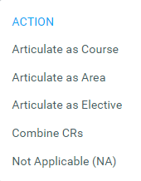
Demonstration
CG
CG

Slide 63
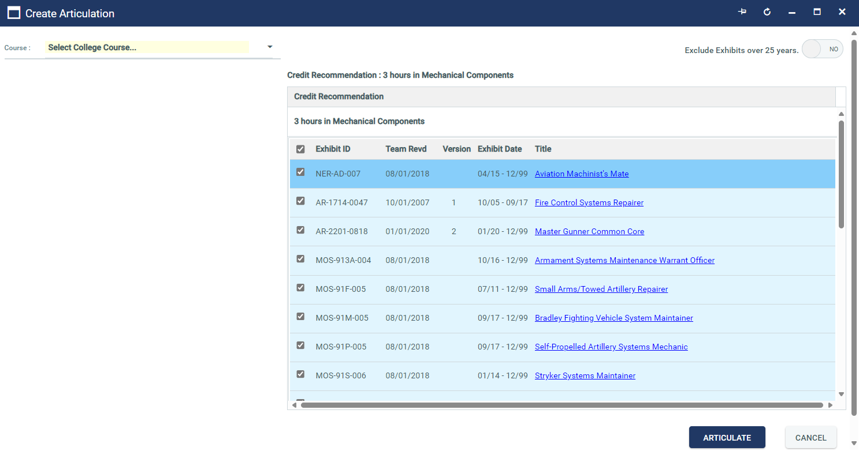
Demonstration
CG
AERO 024 – Aircraft Powerplants – Units: 3.0
CG
CG

Slide 64
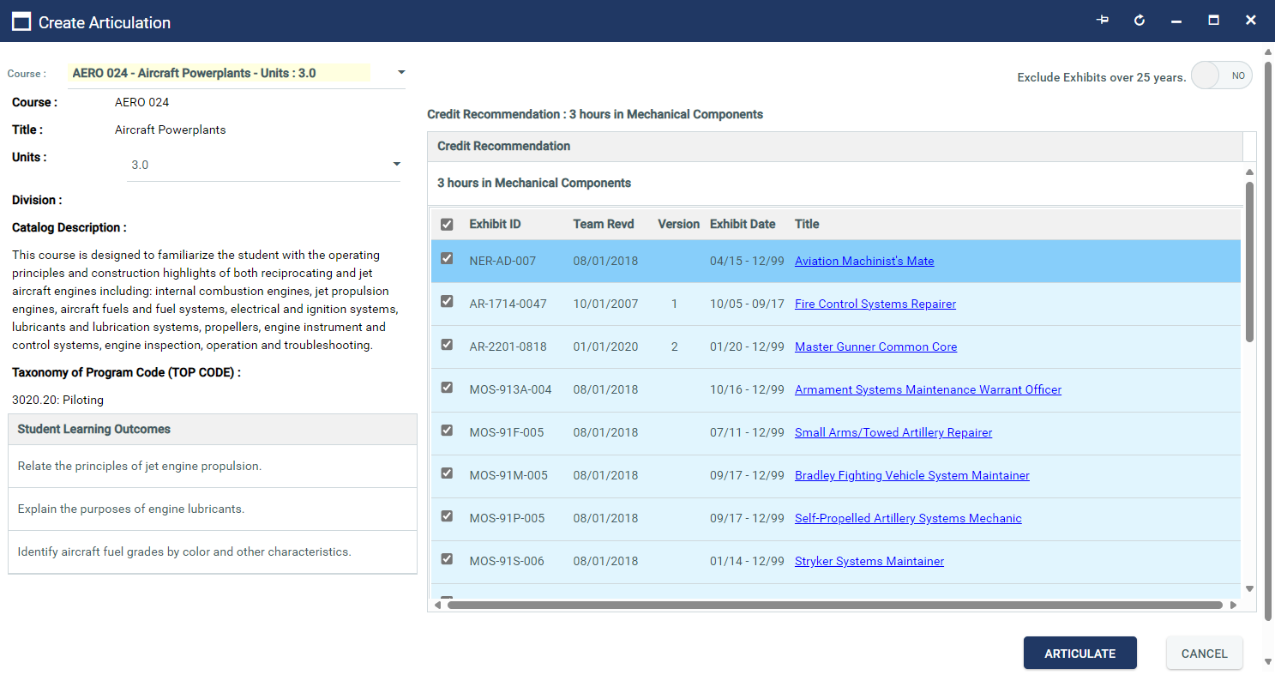
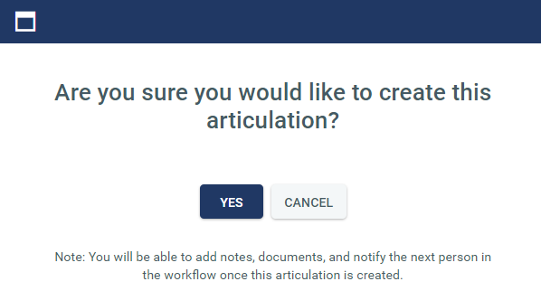
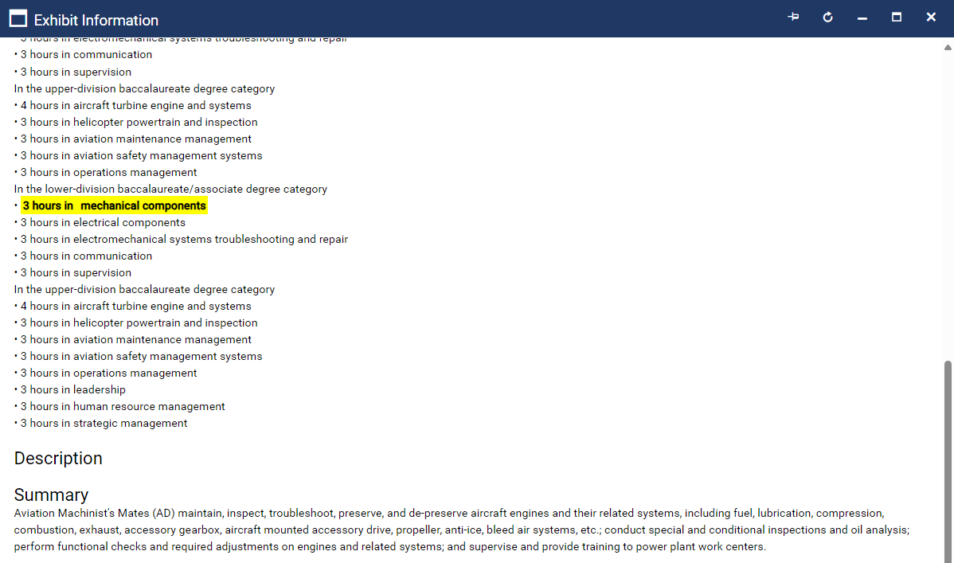
Demonstration
CG
CG
CG

Slide 65
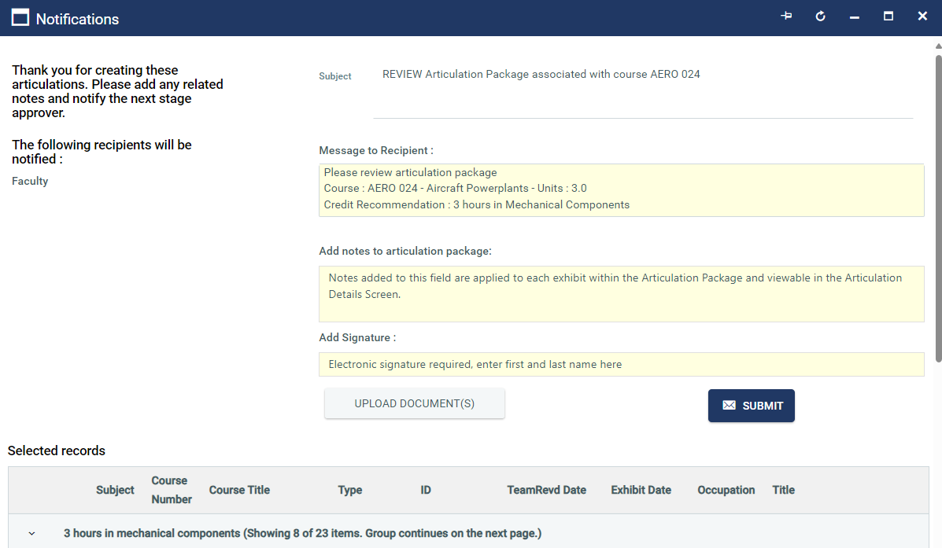
Demonstration
CG
ABC
CG

Slide 66
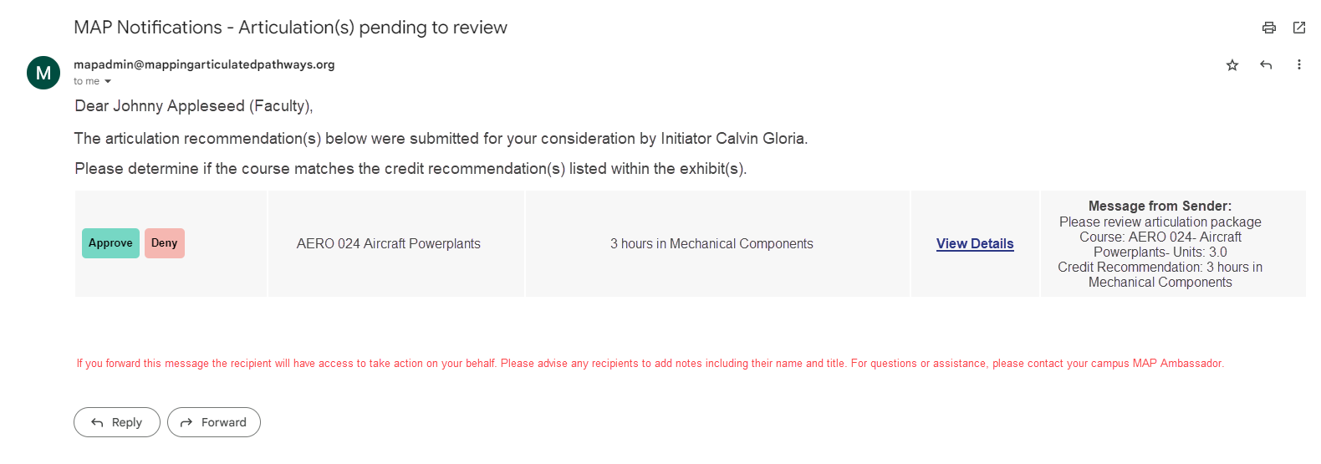
Demonstration
CG
Email Notifications
CG

Slide 67
Demonstration
CG
Course Credit (1)
Faculty
AERO-024 Aircraft Powerplants
3.0
CG

Slide 68
Demonstration
CG
Course Credit (1)
Articulation Officer
AERO-024 Aircraft Powerplants
Course Credit (1)
Faculty
AERO-024 Aircraft Powerplants
3.0
3.0
CG

Slide 69
Demonstration
CG
Course Credit (1)
Implementation
Course Credit (1)
Articulation Officer
AERO-024 Aircraft Powerplants
0.0
Course Credit (1)
Faculty
AERO-024 Aircraft Powerplants
AERO-024 Aircraft Powerplants
3.0
3.0
CG

Slide 70
Demonstration
CG
Area Credit
Implementation
CSU GE-A1 – Oral Communicatio
3.0
Course Credit (1)
Implementation
Course Credit (1)
Articulation Officer
AERO-024 Aircraft Powerplants
0.0
Course Credit (1)
Faculty
AERO-024 Aircraft Powerplants
AERO-024 Aircraft Powerplants
3.0
3.0
Elective Credit
Implementation
CPL-3 Elective Course Credits
3.0
Course Credit (1)
Implementation
AERO-021 Aviation Fundamenta
3.0
CG

Slide 71
Demonstration
CG
15.0
07/30/2024
CG

Slide 72
Demonstration
CG
CG
CG

Slide 73
5th Annual CPL Summit
TN
REGISTER NOW
When: November 1st, 2024 (Friday)
Time: 8:30AM-12:00PM
Modality: Virtual
ALL

Slide 74
Q&A / Contacts
TN
Terence Nelson
Director of Academic and Institutional Partnerships, California MAP Initiative
Email: Terence.Nelson@rccd.edu
Calvin Gloria
Program Manager, California MAP Initiative
Email: Calvin.Gloria@rccd.edu
Phone/Text: (951)218-6073
CA MAP Initiative Website
MAP CPL Repository
ALL

