Slide 1
UNIT COORDINATOR TRAINING

Slide 2
WHAT ARE WE GOING TO COVER?
2023 SECC Contact Information
What is the SECC?
How is the SECC Managed?
How Do Employees Participate?
Guidance for Completing Pledge/Gifts
Leadership Givers
Fundraising
What is an Area Coordinator? What are Their Responsibilities?
What is a Unit Coordinator? What are Their Responsibilities?
Summary of Forms
2023 Important Dates
2023 Goals

Slide 3
2024 SECC CONTACT INFORMATION
UNITED WAY
PEGGI ONDRASEK
President and CEO
1716 Briarcrest Dr Ste 155 Bryan TX 77802
979.696.4483 x 101 | pondrasek@uwbv.org
LOCAL EMPLOYEE CAMPAIGN LIAISON
KIM FOX Manager
Office of Community Engagement
Administration Bldg., Room 318G
1245 TAMU College Station TX 77843
979.845.8008 | kfox@tamu.edu

Slide 4
2024 SECC CONTACT INFORMATION
SYSTEM CAMPAIGN
Joe Elabd Hope mireles
A&M System Campaign Chair A&M System Campaign Manager
Vice Chancellor for Research Vice Chancellor for Research
301 Tarrow Street, 7th Floor 301 Tarrow Street, 7th Floor
College Station, TX 77840 College Station, TX 77840
979-458-6000 yelabd@tamus.edu 979-458-6041 hmireles@tamus.edu

Slide 5
2024 SECC CONTACT INFORMATION
CAMPUS CAMPAIGN
John Mccall Mandy Rutledge
A&M Campus Campaign Chair A&M Campus Campaign Manager
Division of Finance Division of Finance
Jack K. Williams Admin. Bldg, Ste. 202 Jack K. Williams Admin. Bldg., Ste. 202
1181 TAMU 1181 TAMU
College Station, TX 77843 College Station, TX 77843
979-845-5727 | j-mccall@tamu.edu 979-845-5727 | mrutledge@tamu.edu

Slide 6
2024 SECC WEBSITES
STATE OF TEXAS SECC WEBSITE
www.secctexas.org
TAMU & TAMUS SECC WEBSITE
www.tamus.edu/secc
TAMU & TAMUS SECC FACEBOOK PAGE
www.facebook.com/TAMUSECC

Slide 7
WHAT IS THE SECC?
For 25+ years, state, higher education and retired employees have contributed through the SECC to provide support to food banks, homeless or domestic violence shelters, job training programs targeting veterans, and other community programs to help keep Texans healthy, safe, and strong.
Created by Legislation in 1993
First campaign conducted in 1994
Offered Texas state employees greater giving options with hundreds of charitable choices
The only workplace charitable campaign in which state employees can make a voluntary, tax-deductible contribution to charities through payroll deduction, cash, or check
Notes:
Choice!
There are over 400 approved organizations to choose from. You decide which organizations best address your concerns.
Confidence!
All agencies participating in the SECC must meet strict eligibility standards established by state law and are screened by the SECC State Policy Committee. Therefore, you can feel confident your gift is being used efficiently and effectively by your designated charities.
Convenience!
The SECC encourages you to take advantage of the online payroll deduction as a convenient method for giving- monthly or one-time gift

Slide 8
HOW IS THE SECC MANAGED?
Governing and Administrative Structure:
State Policy Committee
State Employee Committee
State Campaign manager
Local Employee Committee
Local Campaign Manager – United Way of the Brazos Valley
Charity Review Process:
Charity Application
Administrative Review
Local Employee Committee Review and Approval
Texas A&M University
Texas A&M University Chair
Texas A&M University System Chair
Texas A&M University
Area Coordinator
TAMUS
Area Coordinators
Texas A&M University Unit Coordinators
TAMUS
Unit Coordinators

Slide 9
CAMPAIGN DATES
Pledge Period: September 1 – October 31
Reports Due to LCM: November 17
Have all deposits and reports to GSC Accounting Services by November 14
Payroll Deductions: January 1 – December 31

Slide 10
HOW DO EMPLOYEES PARTICIPATE?
Donation Options
Single Sign-On Workday – Payroll deduction: sso.tamus.edu
Monthly payroll deductions (9 or 12 month based on employee status with a $2 per charity, per month minimum).
One-time donations to be deducted in January.
Automated Authorization Forms – One-time cash and check gifts only
Checks should be made payable to the SECC.
https://it-lf-ecmf.tamu.edu/Forms/SECC-HigherEducationAuthorizationForm
Credit Card – One-time gift
Donor registers and makes a donation at https://secctexasgiving.org/_brazosvalley/
Select appropriate Employer and fill out registration form
Activate account per email instructions, select charity and make your donation.
Participation in Fundraisers – numerous options for further support
Document donors name for fundraising donations of $24 or more on authorization form
Notes:
Employees paid monthly:
Payroll deductions start in December and will be reflected on January paycheck (of the new calendar year).
Employees paid bi-weekly:
Monthly deductions taken from the second paycheck each month, starting in January.
Payroll deductions are made after taxes have been withheld.
Payroll deductions can be stopped at any time by contacting payroll office.

Slide 11
GUIDANCE FOR COMPLETING PLEDGE/GIFTS
Donor Designation Options
Employees may select the charities they wish to support from the SECC brochure or the SECC directory (available in hardcopy or on the SECC website).
https://www.secctexasgiving.org/
Employees may designate to a single charity or up to six different charities from any three charitable groups. The first 2 digits of the 6-digit agency number identify the charitable group.
Example: 250000 – United Way of the Brazos Valley
Example: 500000 – Adopt-A-Beach
Example: 415062 – Mission Road Ministries
AUTOMATED AUTORHIZATION FORM -- The employee completes the online form and takes a printout with cash/check to Area or Unit Coordinator.

Slide 12
LEADERSHIP GIVERS
Leadership Givers are donors who donate $1,000 or more.
Leadership Givers are recognized for their gift on the SECCTexas.org website and in the printed directory for the next campaign.
Donor can opt to not be acknowledged
Ensure donor’s prefix is listed on form (i.e. Dr., Mr., Mrs., Mr & Mrs) if they want it included in their acknowledgment.
Donations from two employees (spouses) can be combined to meet the Leadership Giving required donation of $1,000 or more.
The Unit Coordinator for each employee needs to email secc@uwbv.org to communicate that the employees wish to be recognized together.

Slide 13
FUNDRAISING
Fundraisers can be a fun way to bring in extra donations.
Check out the Best Practices handout for more great ideas and information.
Select a charity to receive the proceeds from the event.
An authorization form needs to be completed for each fundraiser and charity(ies) need to be selected for the designation.
Document fundraising donations of $24 or more on a separate spreadsheet

Slide 14
AREA COORDINATOR
What is an Area Coordinator?
Manage the campaign activities for divisions of the System and University.
Provide the link between campaign leadership and the Unit Coordinators.
Have Financial Reporting responsibilities.
Administrative Responsibilities:
Work with Administration to set Goal(s) (% or $)
Provides leadership and direction for the campaign in your area.
Appoints unit coordinators to ensure all employees in your area are given the opportunity to participate.
Trains unit coordinators, as necessary.
Serves as a motivator, facilitator, and resource for your unit coordinators.
Deliver weekly deposits on Thursdays

Slide 15
UNIT COORDINATOR
What is a Unit Coordinator?
The front line members of the SECC team.
Distribute materials to employees, fill out and deliver weekly reports
Answer questions to assist with understanding and participating in the SECC.
Share messages with employees on charities in the SECC.
Administrative Responsibilities:
Be familiar with the payroll donation on SSO, authorization form and credit card processes
Host Fundraisers – document names of fundraiser participants who donate $24 or more.
Deliver forms to the Area Coordinators Wednesday by 9 a.m.
Represent your unit at the training workshop and other meetings as scheduled.

Slide 16
UNIT COORDINATOR
WEDNESDAY MORNING “TO DO” LIST
AUTOMATED AUTHORIZATION FORMS
Print confirmation email, copy to employees
Copy to area coordinator with cash/check
Fill out for Fundraisers
Include spreadsheet with list of participants of $24+ donors
 Keep one copy for your files
FORM 2&4 – Cash/Check Donations
Balance cash & checks
Deliver to area coordinator by 9am on Wednesdays
** Keep a copy of everything for your records **

Slide 17
Best Practices
Best Practices for a Successful Campaign
Post signage around offices
Post on your personal social media
Recruit a Team - Make use of your charity’s Ambassador
Incorporate Leadership Giving
Rally the Troops and Make the Ask*
Use the I Gave Button on your email signatures and share in your department.
Distribute the We Give poster to donors to post in their office.
Report, Thank & Inform
*Goal of 100% AWARENESS!
Notes:
Find unique ways to make the “Ask” outside of sending emails which tend to get lost or overlooked.
We will give you a draft post to share on your social media on September 1.

Slide 18
SUMMARY OF FORMS

Slide 19
AUTOMATED AUTHORIZATION FORM
Used by:
Employee: for one-time cash or check gifts only
Unit Coordinator: document fundraiser
Fundraisers: form must be completed for each fundraiser.
Coordinator should select charity(ies) to designate funds.
For “Name” list the unit and title of the fundraiser.
Identify donors who contributed over $24 on a separate spreadsheet to be included with form.
The link to this form is on the SECC website tamus.edu/secc.

Slide 20
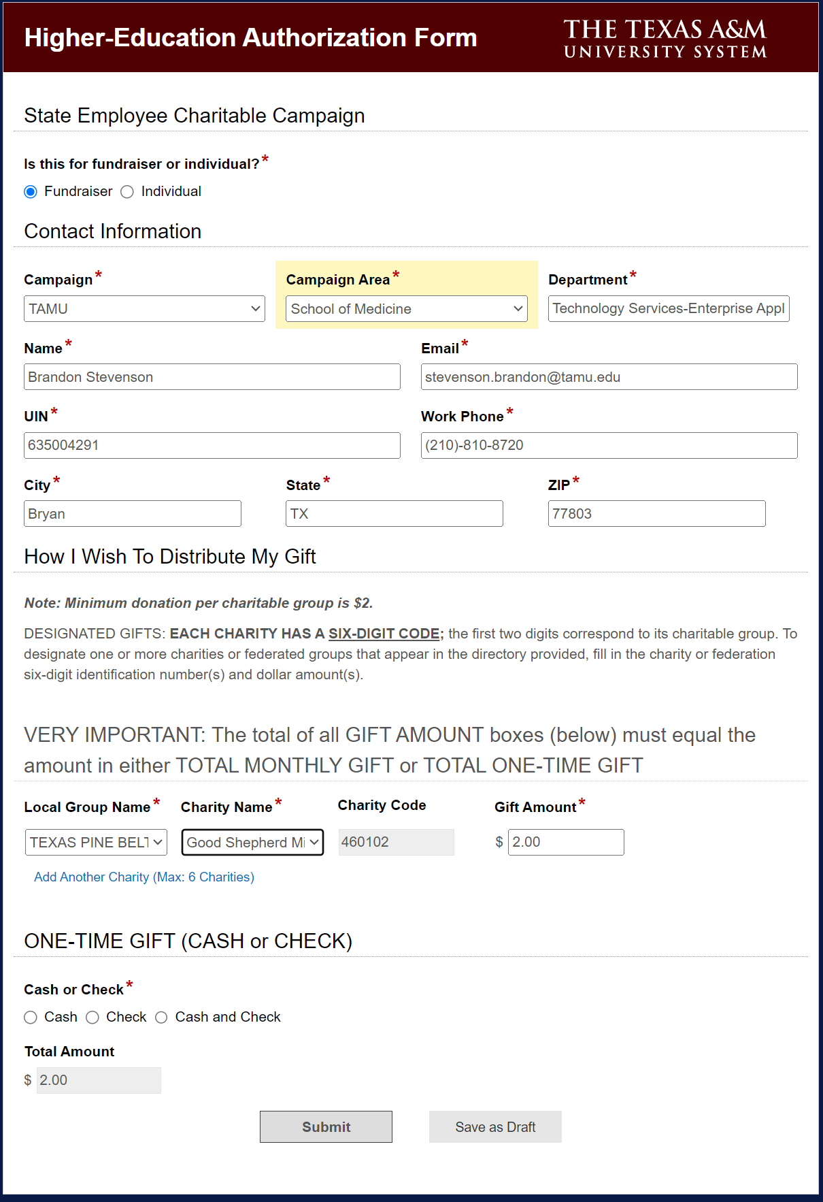
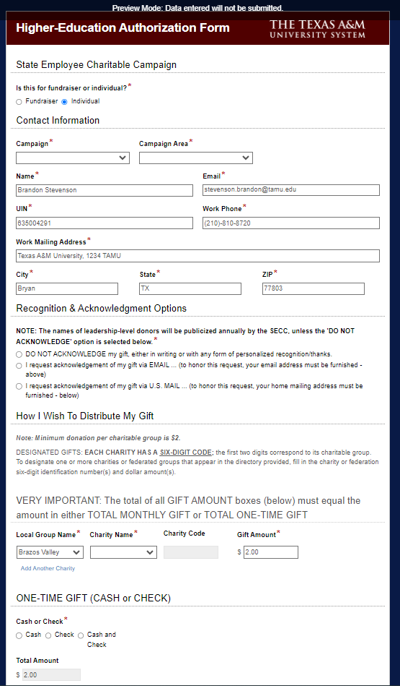
AUTHORIZATION FORM

Slide 21
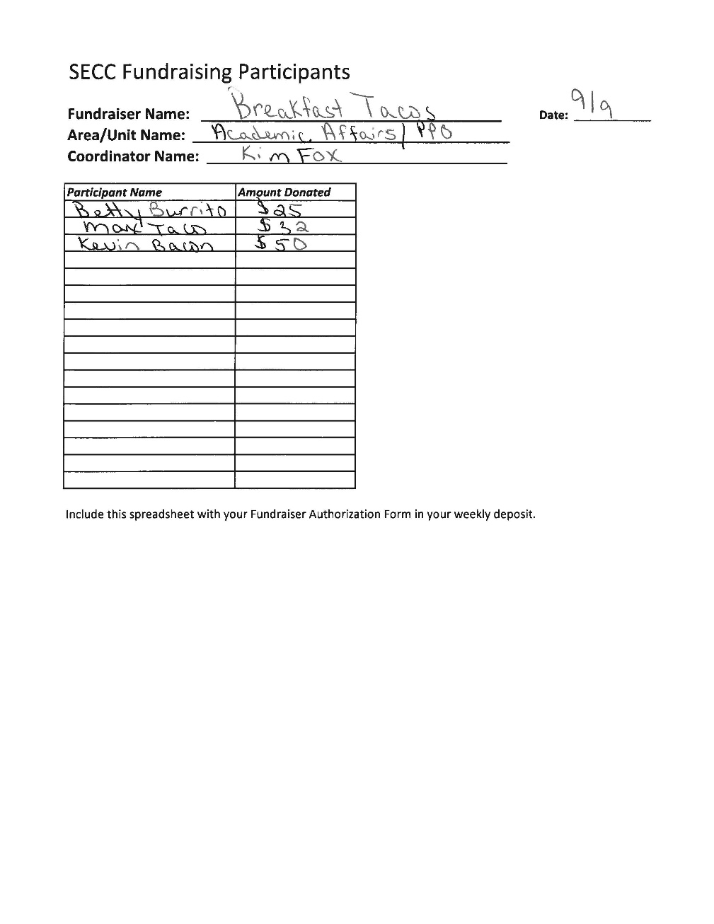
Fundraiser Participants
Used by:
Unit Coordinator: document fundraiser participants of $24 or more
Must be paperclipped to printout of Authorization Form and turned in with weekly deposits.
Available on the website at tamus.edu/secc

Slide 22
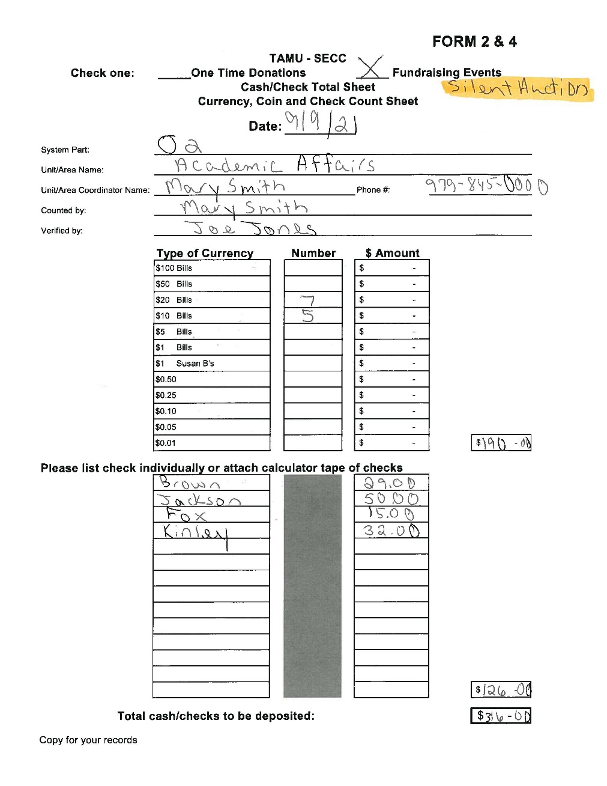
FORM 2&4
Completed by Unit Coordinators; reviewed by Area Coordinators
For all cash and check donations, whether one-time or fundraiser
Retain a copy for your records
Available for download on the SECC website tamus.edu/secc

Slide 23
Trends & Goals
2020
2023
2020
2021
2022
2023
2024 Campaign Goal: University- $300,000
System - $250,000
TOTAL - $550,000
2024 Participation Goal: University - 8%
System – 8%
Notes:
*** An important part of reaching our goals are FUNDRAISERS – Share Handout

Slide 24
SECC 2024 Important Dates
August 21-23 – Distribute Materials
September 1 – Campaign kicks off; SSO and credit card giving sites LIVE
September 4 – Campus email from the President
Wednesdays – Unit Coordinators deliver Forms, Cash and Pledges to Area Coordinators
Thursday – Area Coordinators prepare and deliver deposits to DAS
September 16 – Early Bird Deadlines
October 15 – Better Late Than Never campus deadline
October 31 – Campaign ends
November 14 – Final Processing Deadline!

Slide 25
THANK YOU!!!
For your efforts in making the 2024
State Employee Charitable Campaign a success!
QUESTIONS?

Slide 26
FOR MORE INFORMATION, PLEASE VISIT TAMUS.EDU/SECC
Notes:
TURN IT BACK OVER TO CHAIRS FOR FINAL COMMENTS

